Slide 1
Chameleon Service Training
Dieburg, 06.-10.06.2016
Precompensation
Vision Family

Slide 2
Overview
Theory
Carpe Measurement
Setting the GDD Curve
Chameleon Vision – Precomp Module

Slide 3
Overview
The Vision-Family features an integrated prism-based precompensation module for those customers who wish to mitigate the pulse-broadening effects of their microscope optics.
The standard features of the Chameleon remain the same – this overview describes the additional user options provided to access the precomp functions.

Slide 4
Dispersion: Physical Process
Compensation of chromatic dispersion
Pulse Length Optimization
Group Dispersion Delay (GDD)
Chameleon Vision

Slide 5
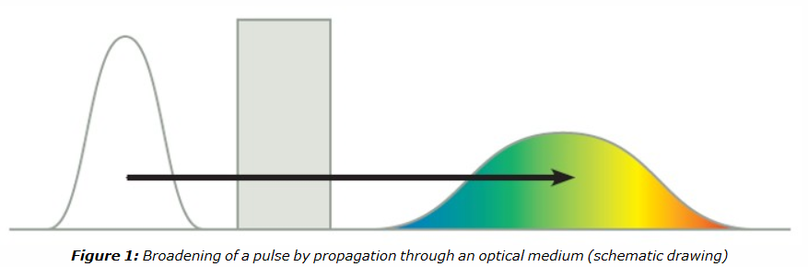
Pulse Length Extention
fs Pulse gets longer by travelling through glass
Pre-compensation – negative Dispersion
Measurement with Autocorrelator CARPE
Target: Creation of a GDD-Curve for individual Setup
Measurement on-site possible

Slide 6
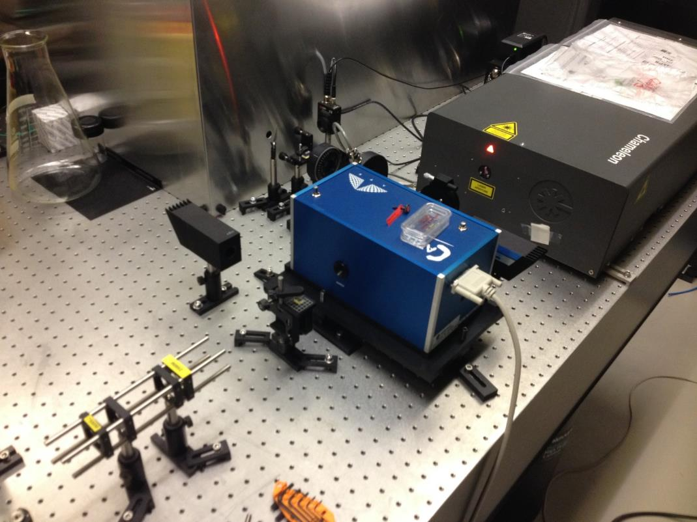
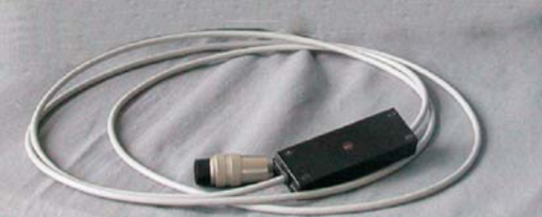
CARPE - Measurement

Slide 7
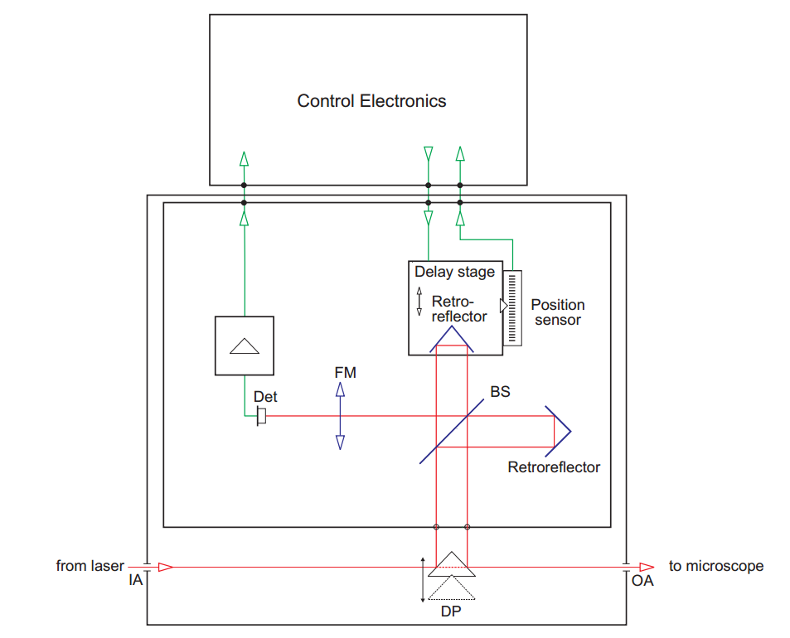
CARPE - Measurement

Slide 8
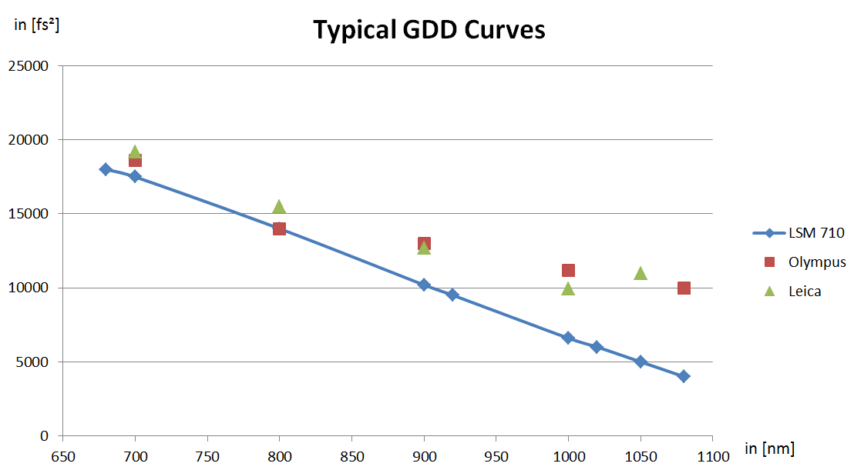
GDD - Curves

Slide 9
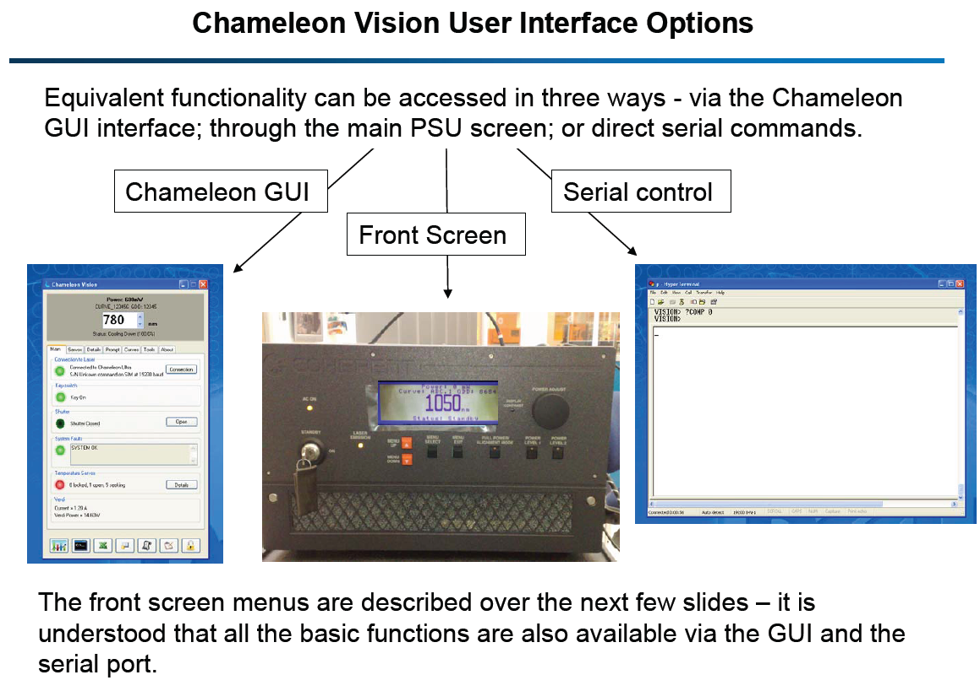
Dispersion Settings Menu

Slide 10
Dispersion Settings: Main Menu
In addition to the standard information, the Chameleon Vision main screen also displays
•The currently-selected precomp ‘curve’
•The current GDD value.
Note that an asterisk (*) beside the GDD value indicates that this value is extrapolated not interpolated.

Slide 11
Dispersion Settings Menu
New Menu Point: Dispersion Settings

Slide 12
Dispersion Settings Menu: Select Curve
> Menu Select

Slide 13
Dispersion Settings Menu: Select Curve
> Menu Select
Displays Current Selected Curve at top of screen.
Nine Available Curves –Menu Up/Down and Select
If MANUAL curve is selected, then the user is prompted to enter a new GDD value, using the rotary knob.
If ZERO curve is selected, then it is the same as Ultra

Slide 14
Dispersion Settings Menu: New Curve
Use rotary knob to select characters
press knob to accept
Menu Up/Down to go back.
Names can contain characters A –Z ; 1 –9; underscore ( _ ) and full stop (.)
Names can be a maximum 6 characters long.

Slide 15
Dispersion Settings Menu: Delete Curve
Select curve to be deleted using the rotary knob.
Additional prompts prevent unintentional deletion.

Slide 16
Dispersion Settings Menu: Calibration
A curve can have a minimum of 3 points, and a maximum of 10.
Inbetween, the GDD value will interpolated
Outside the calibration points, extrapolation gets applied
An asterix (*) shows up:

Slide 17
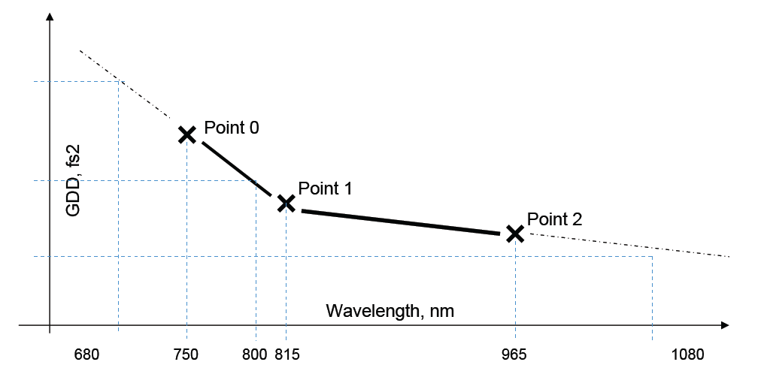
Dispersion Settings Menu: Calibration

Slide 18
Dispersion Settings Menu
A ‘curve’ can be defined with a minimum of 3 points and a maximum of 10.
It is not necessary to cover the entire tuning range 680-1080nm. In this case, if a wavelength is selected which is beyond the currently-selected ‘curve’, a GDD value is extrapolated from the last two known points (up to the maximum available at that wavelength).
It is also possible to select a MANUAL curve and the desired GDD value can be dialled in realtime.

Slide 19
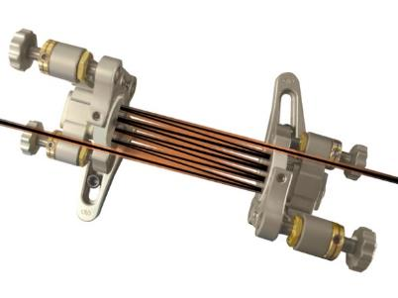
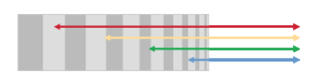
Dispersion Compensation Module
Usage of „chirpted“ mirrors
Different wavelengths penetrate with different depths into the dielectric mirror.
This generated a „Group Delay“
Several reflections increase / decrease chirp
The real beam path and setup is not known to Coherent Field Service

